Slide 1
Clustering

Slide 2
Clustering
Clustering is the process of finding meaningful groups in data.
For example, customers of a company can be grouped based on the purchase behavior. In recent years, clustering has even found its use in political elections
Clustering to describe the data
Clustering for pre-processing

Slide 3
What is Cluster Analysis?
Given a set of objects, place them in groups such that the objects in a group are similar (or related) to one another and different from (or unrelated to) the objects in other groups
Inter-cluster distances are maximized
Intra-cluster distances are minimized

Slide 4
Inter-cluster distances are maximized
Intra-cluster distances are minimized

Slide 5
Types of clustering
Exclusive or strict partitioning clusters
Overlapping clusters
Hierarchical clusters
Based Algorithmic approach
Distance based clustering
Density clustering
Hierarchical clustering

Slide 6
How many clusters?
How many clusters?
Six Clusters
Two Clusters
Four Clusters

Slide 7
Types of Clusterings
A clustering is a set of clusters
Important distinction between hierarchical and partitional sets of clusters
Partitional Clustering
A division of data objects into non-overlapping subsets (clusters)
Hierarchical clustering
A set of nested clusters organized as a hierarchical tree

Slide 8
Partitional Clustering
Original Points
A Partitional Clustering

Slide 9
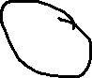

Overlapping Clustering
Original Points
A Partitional Clustering

Slide 10
Hierarchical Clustering
Traditional Hierarchical Clustering
Traditional Dendrogram
Non-traditional Hierarchical Clustering
Non-traditional Dendrogram

Slide 11
Characteristics of the Input Data Are Important
Type of proximity (similarity) or density measure
Central to clustering
Depends on data and application
Data characteristics that affect proximity and/or density are
Dimensionality (# of columns)
Sparseness
Attribute type
Special relationships in the data
For example, autocorrelation
Distribution of the data
Noise and Outliers
Often interfere with the operation of the clustering algorithm

Slide 12
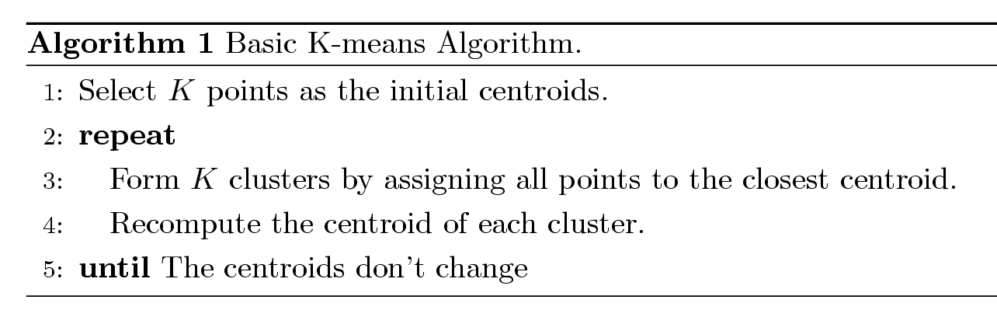
K-means Clustering
Partitional clustering approach
Number of clusters, K, must be specified
Each cluster is associated with a centroid (center point) (mean)
Each point is assigned to the cluster with the closest centroid
The basic algorithm is very simple

Slide 13

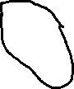

Cluster Centroid
Original Points
A Partitional Clustering

Slide 14
K-means Clustering – Details
Simple iterative algorithm.
Choose initial centroids;
repeat {assign each point to a nearest centroid; re-compute cluster centroids}
until centroids stop changing.
Initial centroids are often chosen randomly.
Clusters produced can vary from one run to another
The centroid is (typically) the mean of the points in the cluster, but other definitions are possible
K-means will converge for common proximity measures with appropriately defined centroid
Most of the convergence happens in the first few iterations.
Often the stopping condition is changed to ‘Until relatively few points change clusters’

Slide 15
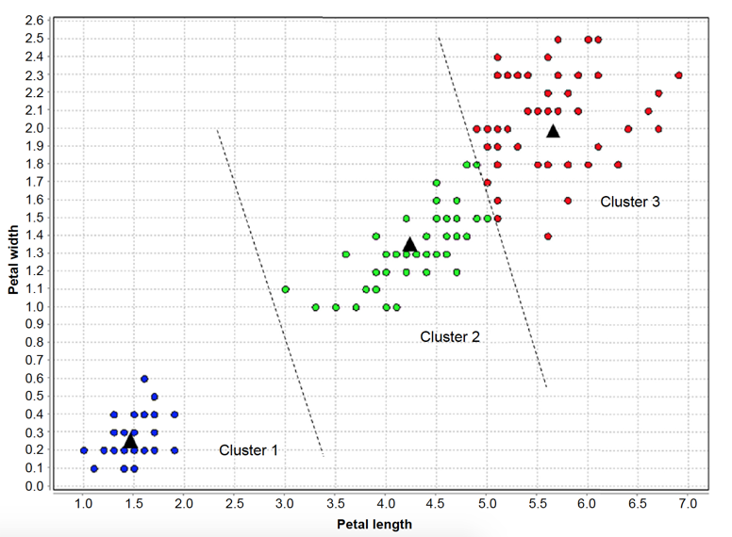
k Partitions
k-means algorithm divides the data space into k partitions or boundaries, where the centroid in each partition is the prototype of the clusters

Slide 16
K Means Algorithm Steps (recap)
Initialize means (centroids)
Assign data points to cluster means
Calculate new means (based on the assigned points for each cluster)
Repeat the process until convergence (no further change in cluster assignments

Slide 17
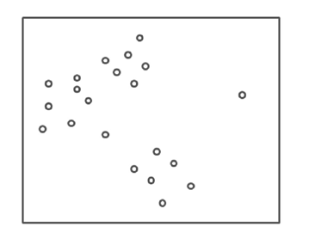
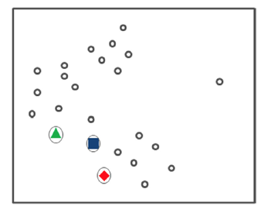
Step 1: Initiate Centroids

Slide 18
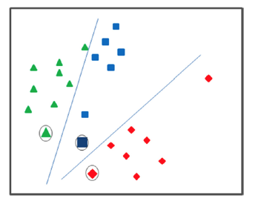
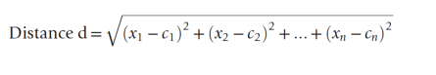
Step 2: Assign Data Points

Slide 19
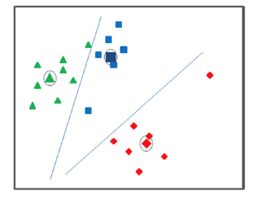
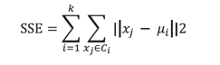
Step 3: Calculate New Centroids
Minimizing the sum of squared errors (SSE)

Slide 20
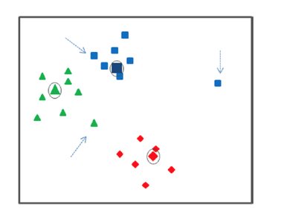
Step 4: Repeat Assignment and Calculate New Centroids

Slide 21
Step 5: Termination
No further change in assignment of data points happens or, in other words, no significant change in centroids are noted.
Evaluation of Clusters
Minimize total SSE

Slide 22
Example of K-means Clustering
Iteration 6
3
2.5
2
1.5
y
1
0.5
0
-2
-1.5
-1
-0.5
0
0.5
1
1.5
2
x

Slide 23
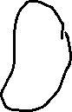
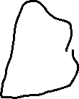
Example of K-means Clustering

Slide 24
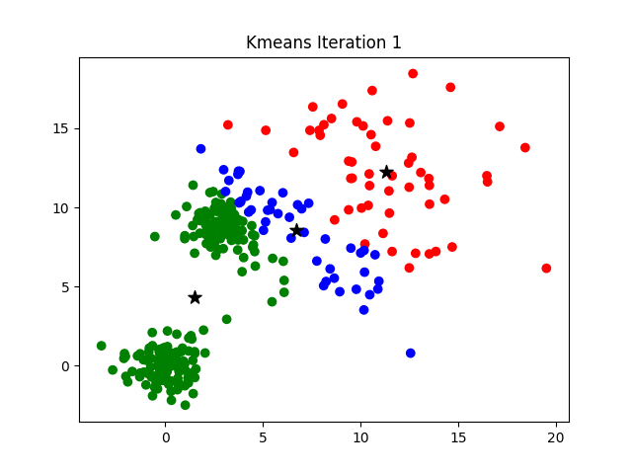

Slide 25
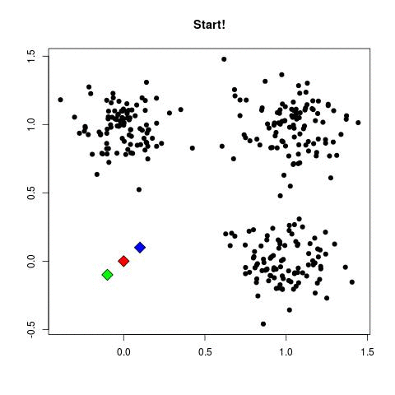

Slide 26
K-means Objective Function
A common objective function (used with Euclidean distance measure) is Sum of Squared Error (SSE)
For each point, the error is the distance to the nearest cluster center
To get SSE, we square these errors and sum them.
x is a data point in cluster C_{i} and m_{i} is the centroid (mean) for cluster C_{i}
SSE improves in each iteration of K-means until it reaches a local or global minima.

Slide 27
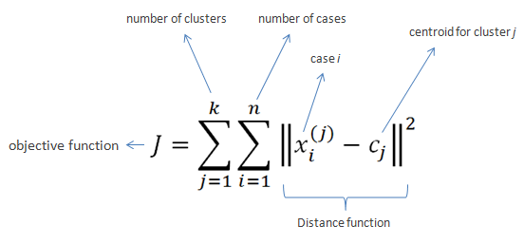
K-means Objective Function

Slide 28
Two different K-means Clustering
Original Points
Optimal Clustering
Sub-optimal Clustering

Slide 29
K Mean Example
Suppose we want to group the visitors to a website using just their age (one-dimensional space) as follows:
n = 19
15,15,16,19,19,20,20,21,22,28,35,40,41,42,43,44,60,61,65
Initial clusters (random centroid or average):
k = 2
c1 = 16
c2 = 22

Slide 30
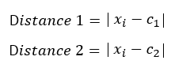
Iteration 1
x_{i} | c₁ | c₂ | Distance 1 | Distance 2 | Nearest Cluster | New Centroid
15 | 16 | 22 | 1 | 7 | 1 | 15.33
15 | 16 | 22 | 1 | 7 | 1
16 | 16 | 22 | 0 | 6 | 1
19 | 16 | 22 | 9 | 3 | 2 | 36.25
19 | 16 | 22 | 9 | 3 | 2
20 | 16 | 22 | 16 | 2 | 2
20 | 16 | 22 | 16 | 2 | 2
21 | 16 | 22 | 25 | 1 | 2
22 | 16 | 22 | 36 | 0 | 2
28 | 16 | 22 | 12 | 6 | 2
35 | 16 | 22 | 19 | 13 | 2
40 | 16 | 22 | 24 | 18 | 2
41 | 16 | 22 | 25 | 19 | 2
42 | 16 | 22 | 26 | 20 | 2
43 | 16 | 22 | 27 | 21 | 2
44 | 16 | 22 | 28 | 22 | 2
60 | 16 | 22 | 44 | 38 | 2
61 | 16 | 22 | 45 | 39 | 2
65 | 16 | 22 | 49 | 43 | 2
c1 = 15.33
c2 = 36.25

Slide 31
Iteration 2
x_{i} | c₁ | c₂ | Distance 1 | Distance 2 | Nearest Cluster | New Centroid
15 | 15.33 | 36.25 | 0.33 | 21.25 | 1 | 18.56
15 | 15.33 | 36.25 | 0.33 | 21.25 | 1
16 | 15.33 | 36.25 | 0.67 | 20.25 | 1
19 | 15.33 | 36.25 | 3.67 | 17.25 | 1
19 | 15.33 | 36.25 | 3.67 | 17.25 | 1
20 | 15.33 | 36.25 | 4.67 | 16.25 | 1
20 | 15.33 | 36.25 | 4.67 | 16.25 | 1
21 | 15.33 | 36.25 | 5.67 | 15.25 | 1
22 | 15.33 | 36.25 | 6.67 | 14.25 | 1
28 | 15.33 | 36.25 | 12.67 | 8.25 | 2 | 45.9
35 | 15.33 | 36.25 | 19.67 | 1.25 | 2
40 | 15.33 | 36.25 | 24.67 | 3.75 | 2
41 | 15.33 | 36.25 | 25.67 | 4.75 | 2
42 | 15.33 | 36.25 | 26.67 | 5.75 | 2
43 | 15.33 | 36.25 | 27.67 | 6.75 | 2
44 | 15.33 | 36.25 | 28.67 | 7.75 | 2
60 | 15.33 | 36.25 | 44.67 | 23.75 | 2
61 | 15.33 | 36.25 | 45.67 | 24.75 | 2
65 | 15.33 | 36.25 | 49.67 | 28.75 | 2
c1 = 18.56
c2 = 45.9

Slide 32
Iteration 3
x_{i} | c₁ | c₂ | Distance 1 | Distance 2 | Nearest Cluster | New Centroid
15 | 18.56 | 45.9 | 3.56 | 30.9 | 1 | 19.50
15 | 18.56 | 45.9 | 3.56 | 30.9 | 1
16 | 18.56 | 45.9 | 2.56 | 29.9 | 1
19 | 18.56 | 45.9 | 0.44 | 26.9 | 1
19 | 18.56 | 45.9 | 0.44 | 26.9 | 1
20 | 18.56 | 45.9 | 1.44 | 25.9 | 1
20 | 18.56 | 45.9 | 1.44 | 25.9 | 1
21 | 18.56 | 45.9 | 2.44 | 24.9 | 1
22 | 18.56 | 45.9 | 3.44 | 23.9 | 1
28 | 18.56 | 45.9 | 9.44 | 17.9 | 1
35 | 18.56 | 45.9 | 16.44 | 10.9 | 2 | 47.89
40 | 18.56 | 45.9 | 21.44 | 5.9 | 2
41 | 18.56 | 45.9 | 22.44 | 4.9 | 2
42 | 18.56 | 45.9 | 23.44 | 3.9 | 2
43 | 18.56 | 45.9 | 24.44 | 2.9 | 2
44 | 18.56 | 45.9 | 25.44 | 1.9 | 2
60 | 18.56 | 45.9 | 41.44 | 14.1 | 2
61 | 18.56 | 45.9 | 42.44 | 15.1 | 2
65 | 18.56 | 45.9 | 46.44 | 19.1 | 2
c1 = 19.5
c2 = 47.89

Slide 33
Iteration 4
x_{i} | c₁ | c₂ | Distance 1 | Distance 2 | Nearest Cluster | New Centroid
15 | 19.5 | 47.89 | 4.50 | 32.89 | 1 | 19.50
15 | 19.5 | 47.89 | 4.50 | 32.89 | 1
16 | 19.5 | 47.89 | 3.50 | 31.89 | 1
19 | 19.5 | 47.89 | 0.50 | 28.89 | 1
19 | 19.5 | 47.89 | 0.50 | 28.89 | 1
20 | 19.5 | 47.89 | 0.50 | 27.89 | 1
20 | 19.5 | 47.89 | 0.50 | 27.89 | 1
21 | 19.5 | 47.89 | 1.50 | 26.89 | 1
22 | 19.5 | 47.89 | 2.50 | 25.89 | 1
28 | 19.5 | 47.89 | 8.50 | 19.89 | 1
35 | 19.5 | 47.89 | 15.50 | 12.89 | 2 | 47.89
40 | 19.5 | 47.89 | 20.50 | 7.89 | 2
41 | 19.5 | 47.89 | 21.50 | 6.89 | 2
42 | 19.5 | 47.89 | 22.50 | 5.89 | 2
43 | 19.5 | 47.89 | 23.50 | 4.89 | 2
44 | 19.5 | 47.89 | 24.50 | 3.89 | 2
60 | 19.5 | 47.89 | 40.50 | 12.11 | 2
61 | 19.5 | 47.89 | 41.50 | 13.11 | 2
65 | 19.5 | 47.89 | 45.50 | 17.11 | 2
c1 = 19.5
c2 = 47.89

Slide 34
K mean result notes
No change between iterations 3 and 4 has been noted.
By using clustering, 2 groups have been identified 15-28 and 35-65.
The initial choice of centroids can affect the output clusters, so the algorithm is often run multiple times with different starting conditions in order to get a fair view of what the clusters should be.
Iteration | Centroid 1 (C1) | Centroid 2 (C2)
Initial | 16 | 22
1 | 15.33 | 36.25
2 | 18.56 | 45.90
3 | 19.50 | 47.89
4 | 19.50 | 47.89

Slide 35
Hierarchical Clustering
Produces a set of nested clusters organized as a hierarchical tree
Can be visualized as a dendrogram
A tree like diagram that records the sequences of merges or splits

Slide 36
Hierarchical Clustering
Traditional Hierarchical Clustering
Traditional Dendrogram
Non-traditional Hierarchical Clustering
Non-traditional Dendrogram

Slide 37

Hierarchical Clustering Animation

Slide 38
Strengths of Hierarchical Clustering
Do not have to assume any number of clusters
Any desired number of clusters can be obtained by ‘cutting’ the dendrogram at the proper level
They may correspond to meaningful taxonomies
Example in biological sciences (e.g., animal kingdom, phylogeny reconstruction, …)

Slide 39
Hierarchical Clustering
Two main types of hierarchical clustering
Agglomerative:
Start with the points as individual clusters
At each step, merge the closest pair of clusters until only one cluster (or k clusters) left
Divisive:
Start with one, all-inclusive cluster
At each step, split a cluster until each cluster contains an individual point (or there are k clusters

Slide 40
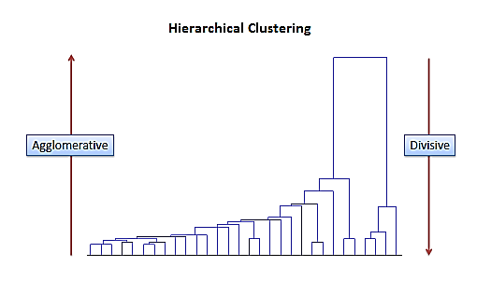
Agglomerative vs divisive hierarchal clustering

Slide 41
Agglomerative Clustering Algorithm
Key Idea: Successively merge closest clusters
Basic algorithm
Compute the proximity matrix
Let each data point be a cluster
Repeat
Merge the two closest clusters
Update the proximity matrix
Until only a single cluster remains
Key operation is the computation of the proximity of two clusters
Different approaches to defining the distance between clusters distinguish the different algorithms

Slide 42
Steps 1 and 2
Start with clusters of individual points and a proximity matrix
p1
p2
p3
p4
p5
. . .
p1
p2
p3
p4
p5
.
.
.
Proximity Matrix

Slide 43
Intermediate Situation
After some merging steps, we have some clusters
C1
C2
C3
C4
C5
C1
C2
C3
C3
C4
C4
C5
Proximity Matrix
C1
C2
C5

Slide 44
Step 4
We want to merge the two closest clusters (C2 and C5) and update the proximity matrix.
C1
C2
C3
C4
C5
C1
C2
C3
C3
C4
C4
C5
Proximity Matrix
C1
C2
C5

Slide 45
Step 5
The question is “How do we update the proximity matrix?”
C2 U C5
C1
C3
C4
C1
?
C2 U C5
? ? ? ?
C3
C3
?
C4
C4
?
Proximity Matrix
C1
C2 U C5

Slide 46
How to Define Inter-Cluster Distance
Similarity?
C1
C2
C3
C4
C5
C1
C2
C3
MIN
MAX
Group Average
Distance Between Centroids
Other methods driven by an objective function
Ward’s Method uses squared error
C4
C5
Proximity Matrix

Slide 47
How to Define Inter-Cluster Similarity
C1
C2
C3
C4
C5
C1
C2
C3
MIN
MAX
Group Average
Distance Between Centroids
Other methods driven by an objective function
Ward’s Method uses squared error
C4
C5
Proximity Matrix

Slide 48
How to Define Inter-Cluster Similarity
C1
C2
C3
C4
C5
C1
C2
C3
MIN
MAX
Group Average
Distance Between Centroids
Other methods driven by an objective function
Ward’s Method uses squared error
C4
C5
Proximity Matrix

Slide 49
How to Define Inter-Cluster Similarity
C1
C2
C3
C4
C5
C1
C2
C3
MIN
MAX
Group Average
Distance Between Centroids
Other methods driven by an objective function
Ward’s Method uses squared error
C4
C5
Proximity Matrix

Slide 50
How to Define Inter-Cluster Similarity
C1
C2
C3
C4
C5
×
×
C1
C2
C3
MIN
MAX
Group Average
Distance Between Centroids
Other methods driven by an objective function
Ward’s Method uses squared error
C4
C5
Proximity Matrix

Slide 51
Hierarchical Clustering: Comparison
5
1
4
1
3
2
5
5
5
2
1
MIN
2
MAX
2
3
6
3
3
6
1
4
4
4
5
1
2
5
2
3
6
Group Average
3
1
4
4

Slide 52
Density based clustering

Slide 53
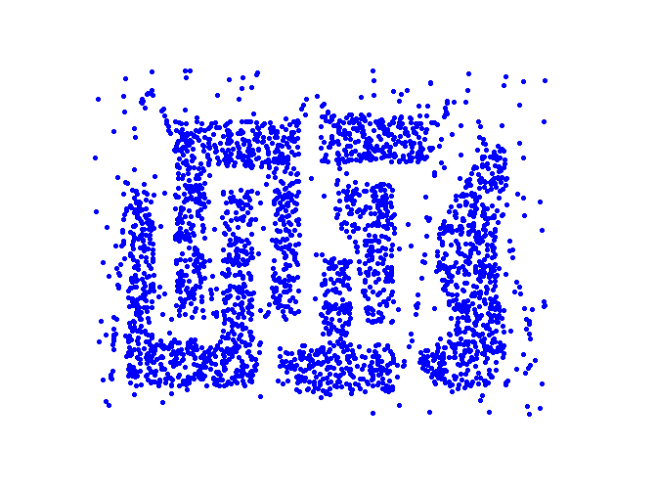
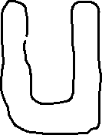
Density Based Clustering
Clusters are regions of high density that are separated from one another by regions on low density.

Slide 54
DBSCAN
DBSCAN is a density-based algorithm.
Density = number of points within a specified radius (Eps)
A point is a core point if it has at least a specified number of points (MinPts) within Eps
These are points that are at the interior of a cluster
Counts the point itself
A border point is not a core point, but is in the neighborhood of a core point
A noise point is any point that is not a core point or a border point

Slide 55
DBSCAN: Core, Border, and Noise Points
MinPts = 7

Slide 56
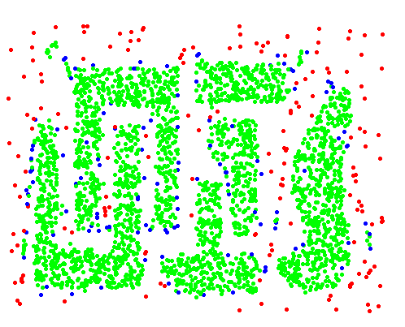
DBSCAN: Core, Border and Noise Points
Point types:
Core Border
Noise Cluster points
Original Points
Eps = 10, MinPts = 4

Slide 57
DBSCAN Algorithm
Form clusters using core points, and assign border points to one of its neighboring clusters
1: Label all points as core, border, or noise points.
2: Eliminate noise points.
3: Put an edge between all core points within a distance Eps of each other.
4: Make each group of connected core points into a separate cluster.
5: Assign each border point to one of the clusters of its associated core points

Slide 58
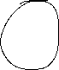
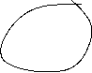
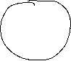
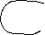
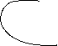
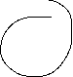
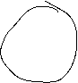
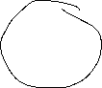
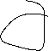
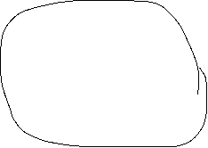
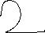
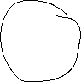
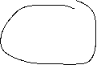
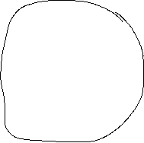

Slide 59
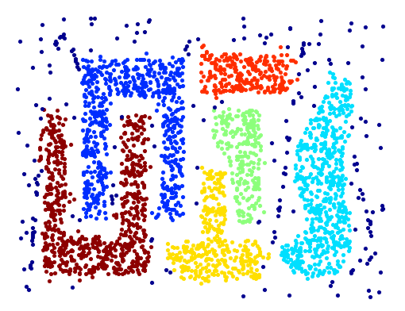
When DBSCAN Works Well
Original Points
Clusters (dark blue points indicate noise)
Can handle clusters of different shapes and sizes
Resistant to noise

Slide 60
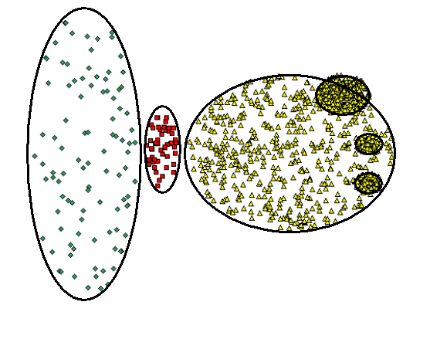
When DBSCAN Does NOT Work Well
Original Points

Slide 61
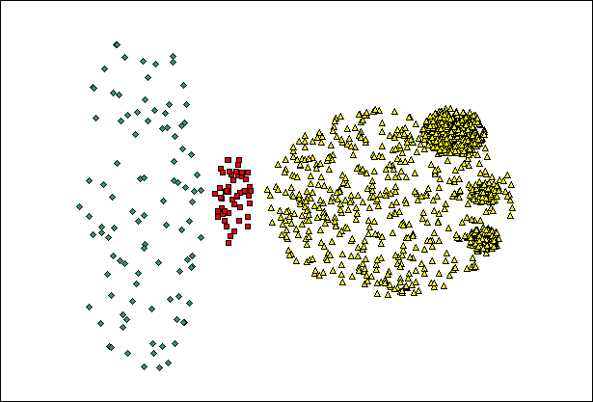
When DBSCAN Does NOT Work Well
Original Points
Varying densities
High-dimensional data
(MinPts=4, Eps=9.92).

Slide 62
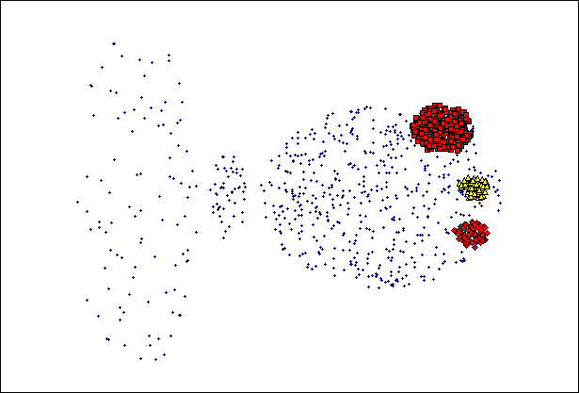
When DBSCAN Does NOT Work Well
Original Points
Varying densities
High-dimensional data
(MinPts=4, Eps=9.75)

Slide 63
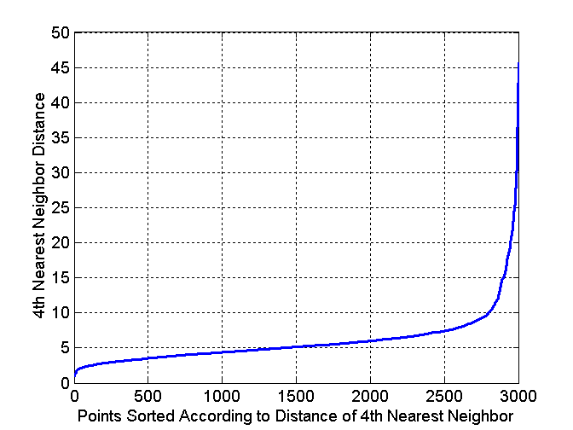
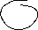
DBSCAN: Determining EPS and MinPts
Idea is that for points in a cluster, their k^{th} nearest neighbors are at close distance
Noise points have the k^{th} nearest neighbor at farther distance
So, plot sorted distance of every point to its k^{th} nearest neighbor

Slide 64
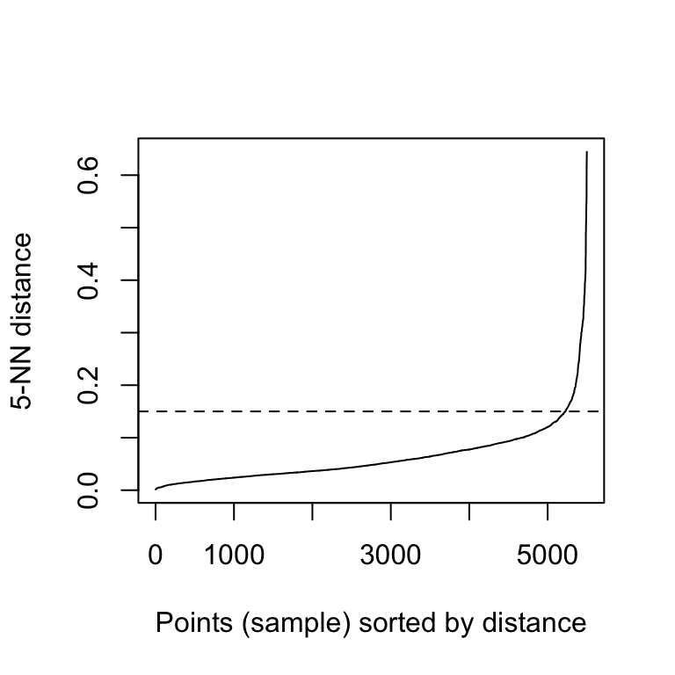
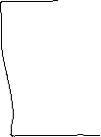
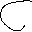
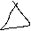
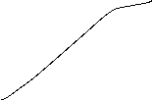
DBSCAN Optimal parameters
The aim is to determine the “knee”, which corresponds to the optimal eps parameter.
A knee corresponds to a threshold where a sharp change occurs along the k-distance curve.

Slide 65
Cluster Validity

Slide 66
Cluster Validity
For supervised classification we have a variety of measures to evaluate how good our model is
Accuracy, precision, recall
For cluster analysis, the analogous question is how to evaluate the “goodness” of the resulting clusters?
But “clusters are in the eye of the beholder”!
In practice the clusters we find are defined by the clustering algorithm
Then why do we want to evaluate them?
To avoid finding patterns in noise
To compare clustering algorithms
To compare two sets of clusters
To compare two clusters

Slide 67
Clusters found in Random Data
DBSCAN
Random Points
K-means
Complete Link

Slide 68
Measures of Cluster Validity
Numerical measures that are applied to judge various aspects of cluster validity, are classified into the following two types.
Supervised: Used to measure the extent to which cluster labels match externally supplied class labels.
Entropy
Often called external indices because they use information external to the data
Unsupervised: Used to measure the goodness of a clustering structure without respect to external information.
Sum of Squared Error (SSE)
Often called internal indices because they only use information in the data
You can use supervised or unsupervised measures to compare clusters or clustering

Slide 69
Supervised Measures of Cluster Validity: Entropy and Purity

Slide 70
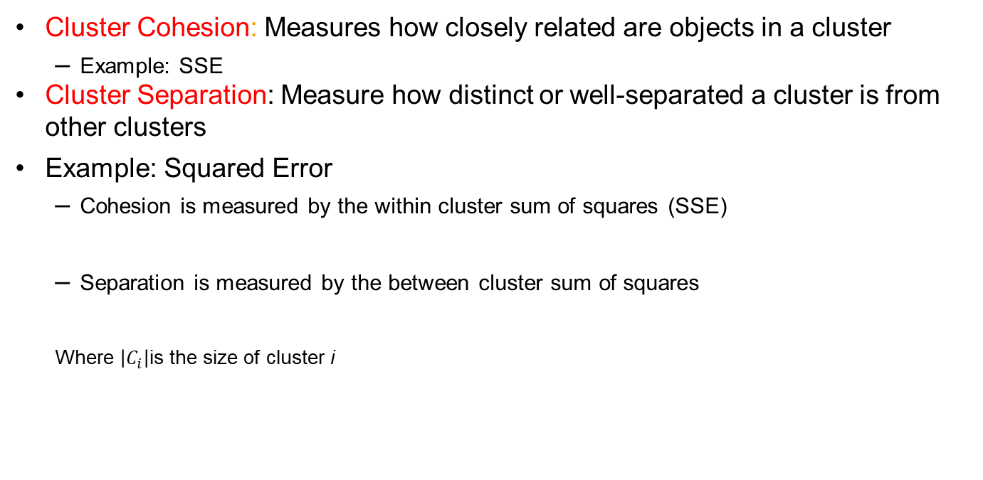
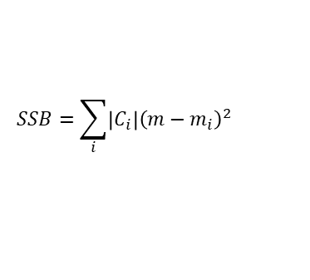
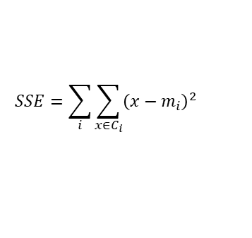
Unsupervised Measures: Cohesion and Separation
Cluster Cohesion: Measures how closely related are objects in a cluster
Example: SSE
Cluster Separation: Measure how distinct or well-separated a cluster is from other clusters
Example: Squared Error
Cohesion is measured by the within cluster sum of squares (SSE)
Separation is measured by the between cluster sum of squares
Where $\left|C_{i}\right|$is the size of cluster i
$$SSE=\sum_{i}{\sum_{x∈C_{i}}{{\left(x−m_{i}\right)}^{2}}}$$
$$SSB=\sum_{i}{\left|C_{i}\right|{\left(m−m_{i}\right)}^{2}}$$

Slide 71
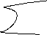













Slide 72









Slide 73





Slide 74



Unsupervised Measures: Cohesion and Separation
Example: SSE
SSB + SSE = constant
m
×
×
×
1
m₁
2
3
4
m₂
5
K=1 cluster:
$$SSE={\left(1−3\right)}^{2}+{\left(2−3\right)}^{2}+{\left(4−3\right)}^{2}+{\left(5−3\right)}^{2}=10$$
$$SSB=4×{\left(3−3\right)}^{2}=0$$
$$Total=10+0=10$$
K=2 clusters:
$$SSE={\left(1−1.5\right)}^{2}+{\left(2−1.5\right)}^{2}+{\left(4−4.5\right)}^{2}+{\left(5−4.5\right)}^{2}=1$$
$$SSB=2 ×{\left(3−1.5\right)}^{2}+2×{\left(4.5−3\right)}^{2}=9$$
$$Total=1+9=10$$

Slide 75


















Slide 76
Unsupervised Measures: Cohesion and Separation
A proximity graph-based approach can also be used for cohesion and separation.
Cluster cohesion is the sum of the weight of all links within a cluster.
Cluster separation is the sum of the weights between nodes in the cluster and nodes outside the cluster.
cohesion
separation

Slide 77
Unsupervised Measures: Silhouette Coefficient
Silhouette coefficient combines ideas of both cohesion and separation, but for individual points, as well as clusters and clusterings
For an individual point, i
Calculate a = average distance of i to the points in its cluster
Calculate b = min (average distance of i to points in another cluster)
The silhouette coefficient for a point is then given by s = (b – a) / max(a,b)
Value can vary between -1 and 1
Typically ranges between 0 and 1.
The closer to 1 the better.
Can calculate the average silhouette coefficient for a cluster or a clustering

Slide 78








Unsupervised Measures: Silhouette Coefficient

Slide 79
Measuring Cluster Validity Via Correlation
Two matrices
Proximity Matrix
Ideal Similarity Matrix
One row and one column for each data point
An entry is 1 if the associated pair of points belong to the same cluster
An entry is 0 if the associated pair of points belongs to different clusters
Compute the correlation between the two matrices
Since the matrices are symmetric, only the correlation between n(n-1) / 2 entries needs to be calculated.
High magnitude of correlation indicates that points that belong to the same cluster are close to each other.
Correlation may be positive or negative depending on whether the similarity matrix is a similarity or dissimilarity matrix
Not a good measure for some density or contiguity based clusters.

Slide 80





Slide 81
Measuring Cluster Validity Via Correlation
Correlation of ideal similarity and proximity matrices for the K-means clusterings of the following well-clustered data set.
Corr = 0.9235

Slide 82
Measuring Cluster Validity Via Correlation
Correlation of ideal similarity and proximity matrices for the K-means clusterings of the following random data set.
K-means
Corr = 0.5810

Slide 83
Judging a Clustering Visually by its Similarity Matrix
Order the similarity matrix with respect to cluster labels and inspect visually.

Slide 84
Judging a Clustering Visually by its Similarity Matrix
Clusters in random data are not so crisp
DBSCAN

Slide 85
Judging a Clustering Visually by its Similarity Matrix
DBSCAN

Slide 86
Determining the Correct Number of Clusters
SSE is good for comparing two clusterings or two clusters
SSE can also be used to estimate the number of clusters

Slide 87




Determining the Correct Number of Clusters

Slide 88

Determining the Correct Number of Clusters
SSE curve for a more complicated data set
SSE of clusters found using K-means

Slide 89





Determining the Correct Number of Clusters
SSE curve for a more complicated data set
SSE of clusters found using K-means

Slide 90




Optimal Number of clusters

Slide 91

Optimal Number of clusters
Elbow method: 4 clusters solution suggested
Silhouette method: 2 clusters solution suggested
Gap statistic method: 4 clusters solution suggested

Slide 92
Elbow method
Compute clustering algorithm (e.g., k-means clustering) for different values of k. For instance, by varying k from 1 to 10 clusters.
For each k, calculate the total within-cluster sum of square (wss) (SSE).
Plot the curve of wss according to the number of clusters k.
The location of a bend (knee) in the plot is generally considered as an indicator of the appropriate number of clusters.

Slide 93
Final Comment on Cluster Validity
“The validation of clustering structures is the most difficult and frustrating part of cluster analysis.
Without a strong effort in this direction, cluster analysis will remain a black art accessible only to those true believers who have experience and great courage.”
Algorithms for Clustering Data, Jain and Dubes
H. Xiong and Z. Li. Clustering Validation Measures. In C. C. Aggarwal and C. K. Reddy, editors, Data Clustering: Algorithms and Applications, pages 571–605. Chapman & Hall/CRC, 2013.

